Slide 1
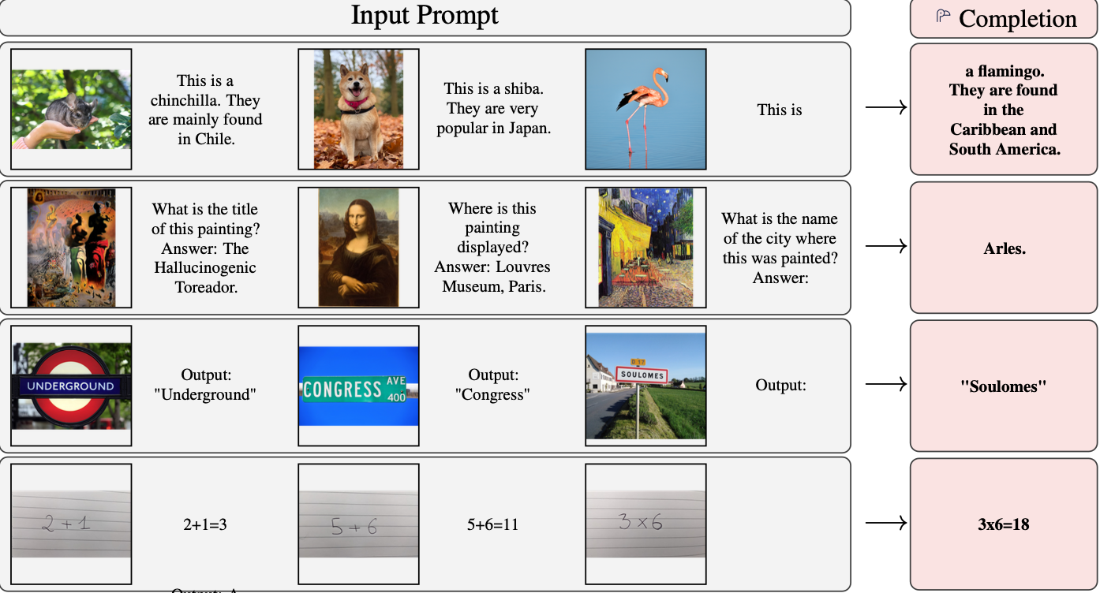
Flamingo: a Visual Language Model for Few-Shot Learning
What is Flamingo? A multimodal model that combines vision and language for few-shot learning, enabling robust performance across diverse tasks without task-specific fine-tuning.
Motivation:
Traditional visual models require task specific fine tuning
and large annotated datasets.
Flamingo addresses this by enabling few shot learning
across image, video and text tasks
References/Image credits
J-B. Alayrac et al., "Flamingo: a Visual Language Model for Few-Shot Learning", arxiv (2022)
Notes:
Traditional methods rely on extensive fine-tuning with thousands of annotations (e.g., ImageNet, COCO) require significant manual labeling. Model Specialization: Task-specific models like CLIP or BLIP lack generalizability. Multimodal Fusion: Balancing alignment (e.g., image-text) with flexibility for downstream tasks.

Slide 2
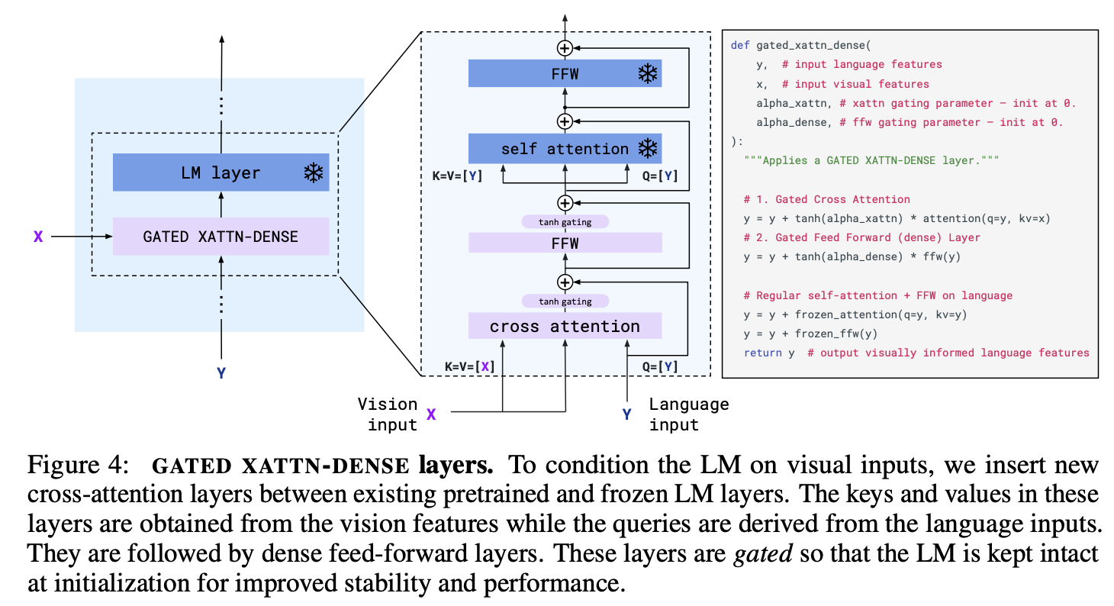
Bridge powerful pretrained vision-only and language-only models
Training from scratch is extremely
computationally expensive
Start from a pretrained language model
Text-only model has no built-in way to
incorporate input from other modalities.
Flamingo: interleave cross-attention layers with
language-only self-attention layers (frozen)
References/Image credits
J-B. Alayrac et al., "Flamingo: a Visual Language Model for Few-Shot Learning", arxiv (2022)
Notes:
We want to enable incorporation of inputs from other modalities while retaining the knowledge of the original language model(chinchillas)

Slide 3
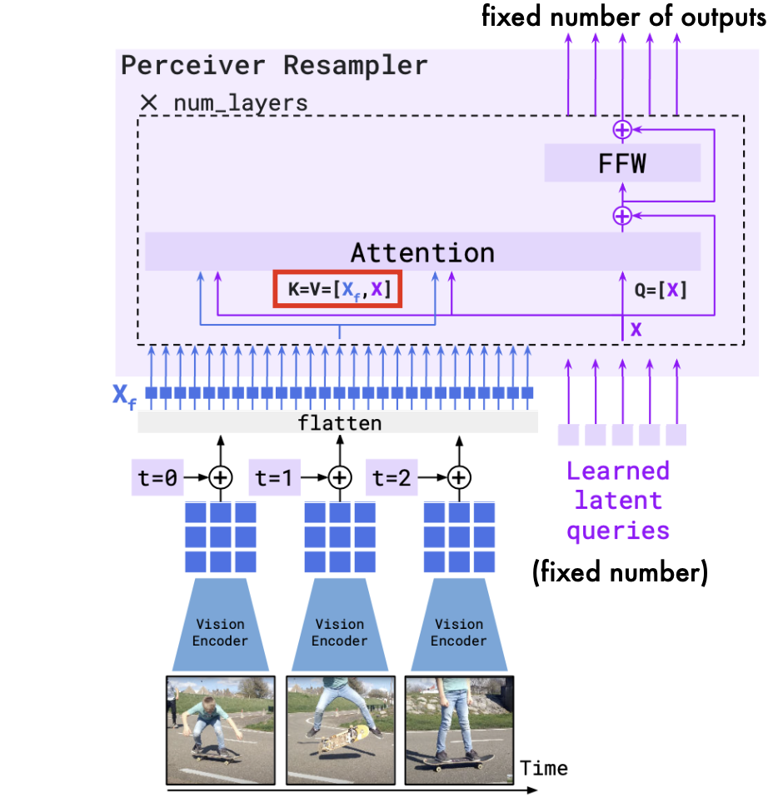
Unified handling of images and videos
Both image and video inputs are high dimensional
Flattening these inputs into 1-D sequences as is done in text generation, is computationally expensive
It is exacerbated by the quadratic cost of self-attention layers
Flamingo: Uses a perceiver-resampler processes inputs into fixed visual tokens, incorporates temporal encodings for videos and combines learned latent queries with visual embeddings through attention.

Slide 4
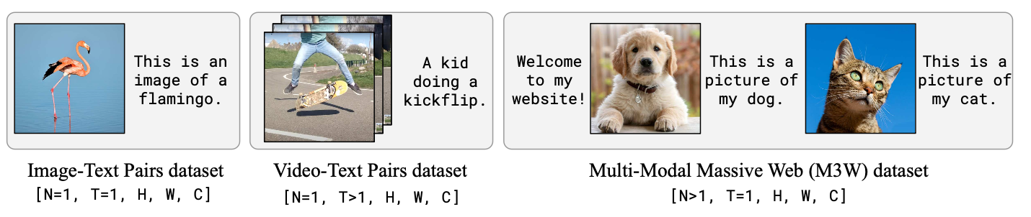
Training Dataset
The existing (image, text) datasets used by CLIP or ALIGN are not general enough for few shot learning
Multimodal datasets are scarce in comparison to abundantly available text-only data
One approach is to scrape web pages for interleaved images and text however these pairs are often only weakly related
Flamingo: combines web scraping with existing paired (image, text) and (video, text) datasets

Slide 5
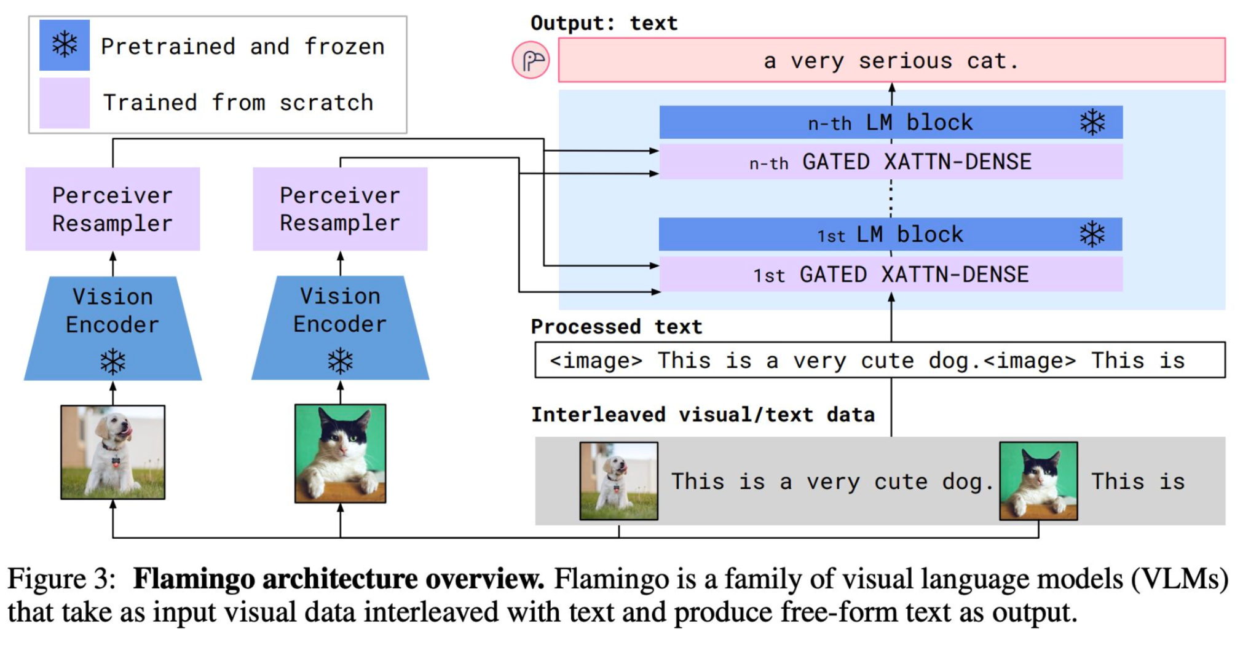
Flamingo Architecture
References/Image credits
J-B. Alayrac et al., "Flamingo: a Visual Language Model for Few-Shot Learning", arxiv (2022)

Slide 6
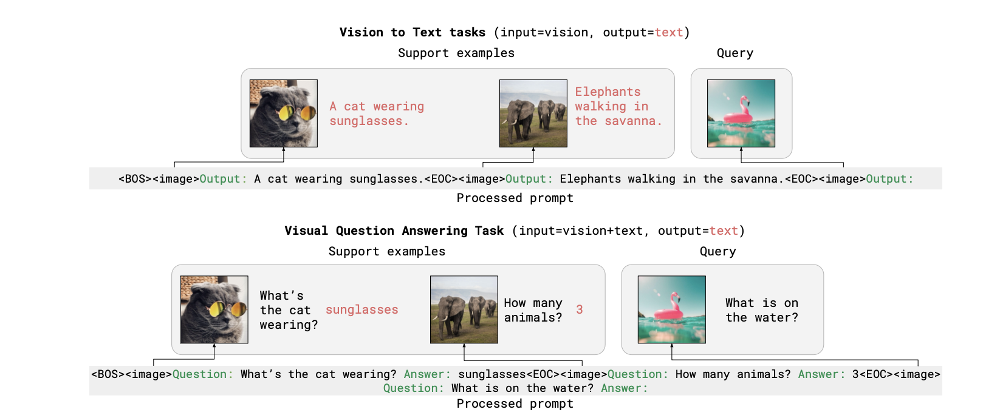

Slide 7
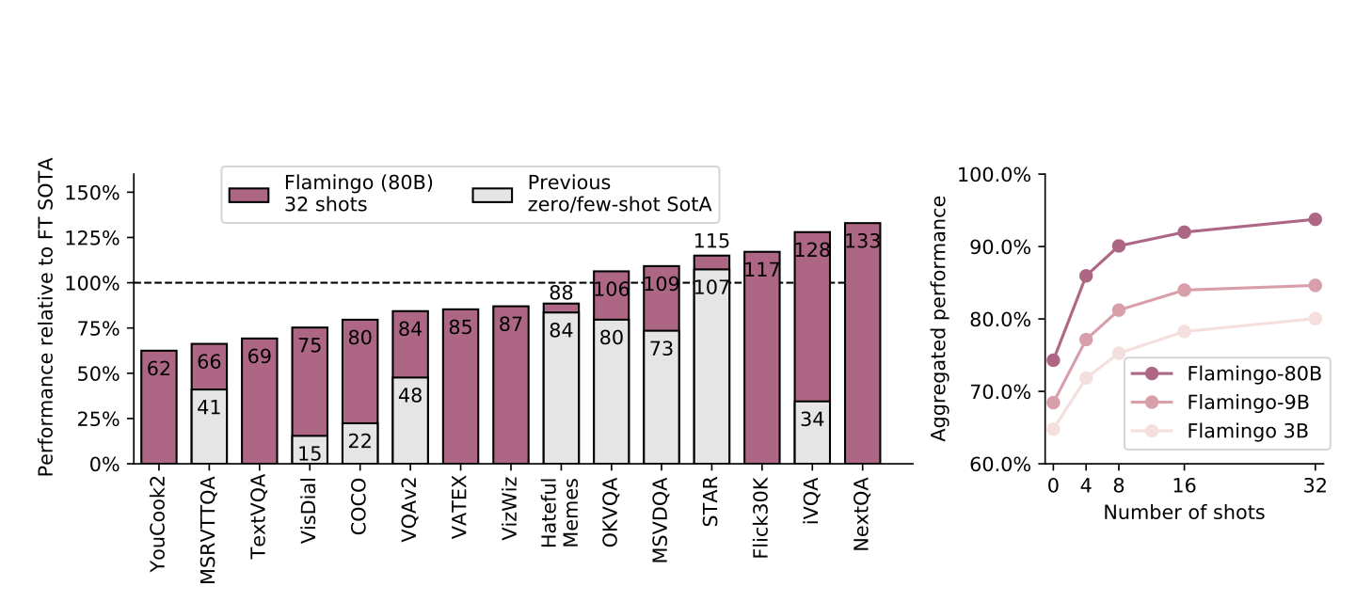
Results

Slide 8
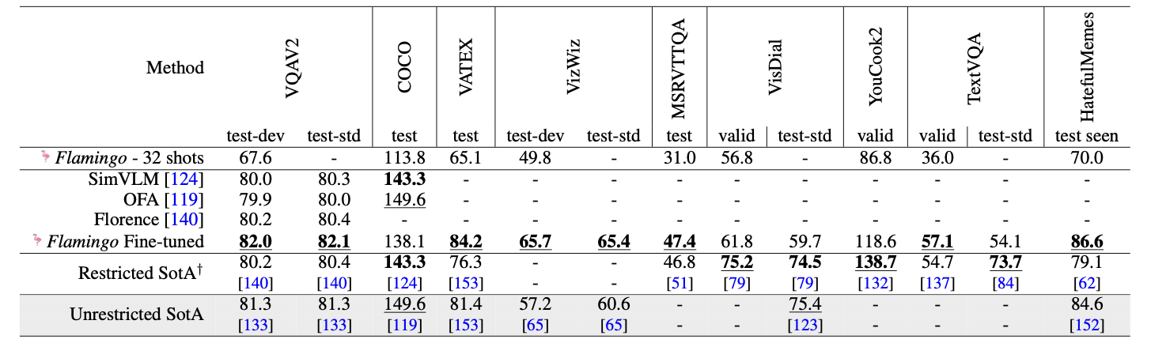
With Finetuning
During fine-tuning, Flamingo keeps the language model layers frozen
The base vision encoder is also fine-tuned (unlike Flamingo pretraining)
Hyperparameters are set by grid search on validation subsets of the training sets
Search over: learning rate, decay schedule, training steps, batch size, augmentation

